Slide 1
A Long Look at Love
(San Francisco Edition)
Rodrigo Arguello

Slide 2

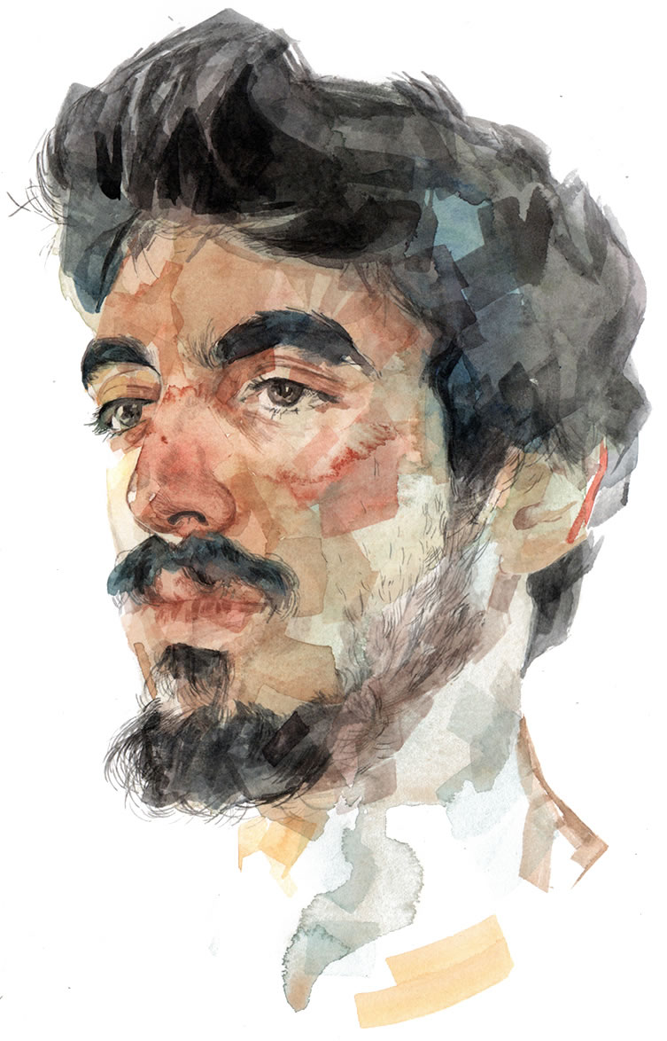

Project Overview
The goal of this project is to get to know the OKCupid population of San Francisco to decide whether it is worth using the app for dating there. To do so, this project will find out the kinds of people that populate the scene as well as whether they reflect the population around them.

Slide 3

Data Overview
OKCupid data for 59,946 users in San Francisco, June 2012.
Dataset cleaned from the OkCupid Profile Data for Introductory Statistics and Data Science Courses (Journal of Statistics Education 2015).
The dataset contains typical user data, lifestyle habits, declared income and education, and answers to 10 essay questions.

Slide 4
Data Overview
Sex | Age | Body Type | Diet | Drinks | Drugs | Ethnicity | Income | Religion | Orientation
Male / Female | 18+ | Average, fit, thin, etc. | Vegan, eat anything, etc. | Never, sometimes, socially, etc. | Never, sometimes, often | White, asian, black, etc. | 0+ | Christianity, atheism, hinduism, other, etc. | Straight, gay, bisexual
The analysis will focus on the users’ physical attributes, several habits, ethnicity, income, religion, and orientation.

Slide 5
Questions
First few questions reveal:
Distribution of age and gender
Most common physical attributes
Next few questions reveal:
Drug, drinking, and diet habits of users
Last few questions show:
How OKCupid users compare to the average San Francisco resident or, in the absence of that information, American

Slide 6
What kinds of people populate the San Francisco dating scene?
For both genders...
What’s the main age range?
How fit are users?
Which religions are the most common?
Which ethnicities are most prevalent?
Is there a high proportion of LGBTQ users?
Answering these questions will shed some light on the most common traits OKCupid users see. This will help give us an idea of the kinds of people we’d expect to find in SF OKCupid.

Slide 7
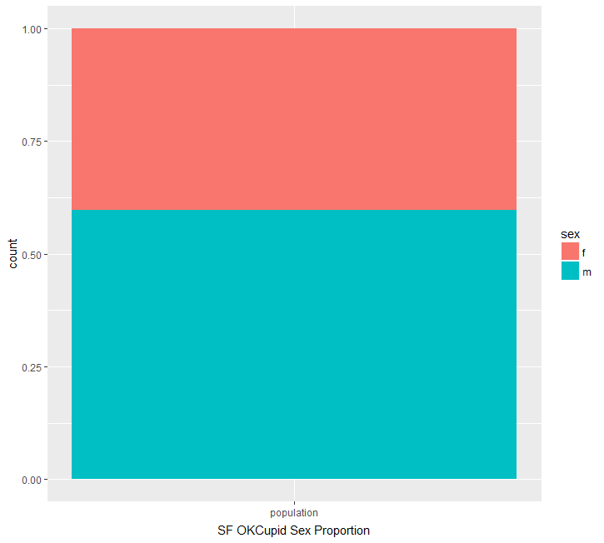
What kinds of people populate the San Francisco dating scene?
-Sex
Sex selected.
X axis is a single category.
Y axis shows proportion as fraction of 1.
Color shows Sex (M/F)
More Males than Females (6:4)

Slide 8
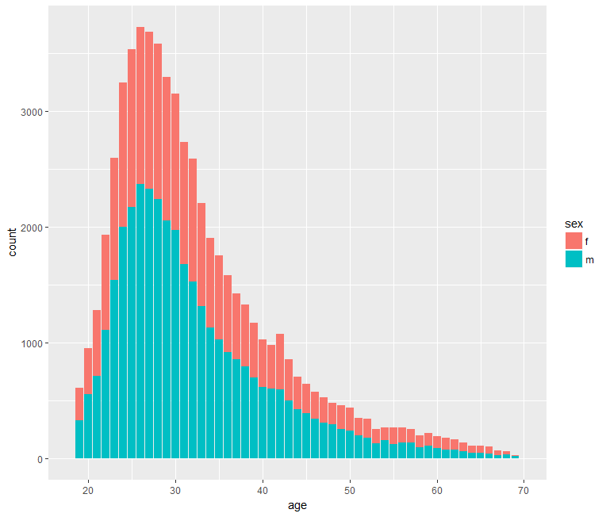
What kinds of people populate the San Francisco dating scene?
-Age and Sex
Age and Sex selected.
X axis shows Age by single years.
Y axis shows frequency for each year.
Color shows Sex (M/F)
Most users in the 22-33 age range
Most common age is 26

Slide 9
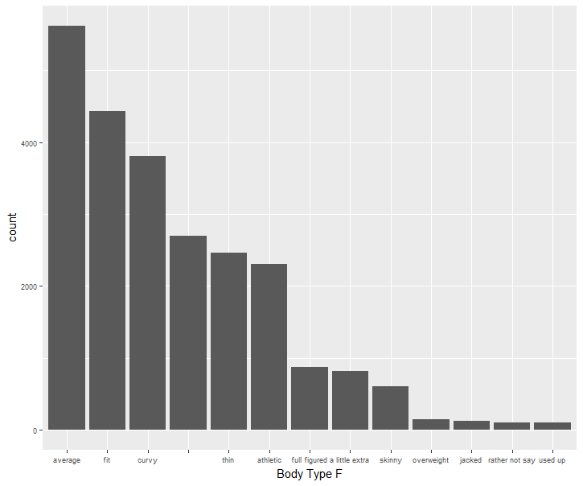
What kinds of people populate the San Francisco dating scene?
-Body Type by Sex = Female
Body Type and Sex selected.
Filtered Sex by Female.
X axis shows options for body type.
Y axis shows frequency for each body type.
Noticeable right-skew
Relatively steep incline until last seven body types.

Slide 10
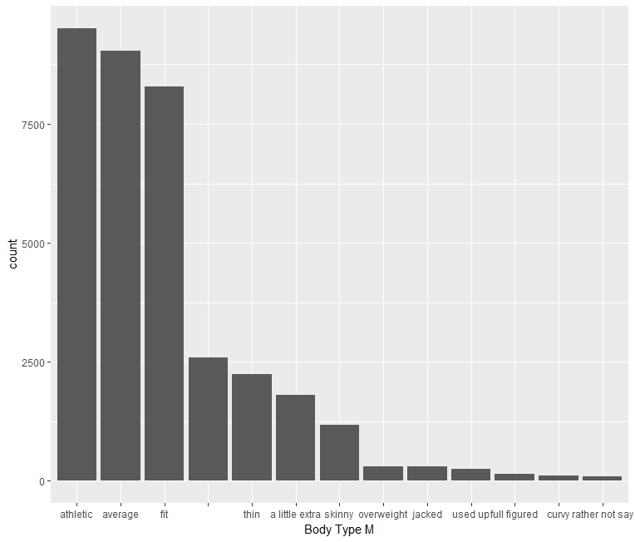
What kinds of people populate the San Francisco dating scene?
-Body Type by Sex = Male
Body Type and Sex selected.
Filtered Sex by Male.
X axis shows options for body type.
Y axis shows frequency for body types.
Strong right-skew
Top 3 results far above the rest
Sharp drop after “fit”
Gentle slope afterwards

Slide 11
What kinds of people populate the San Francisco dating scene?
-Body Type by Both Sexes

Slide 12
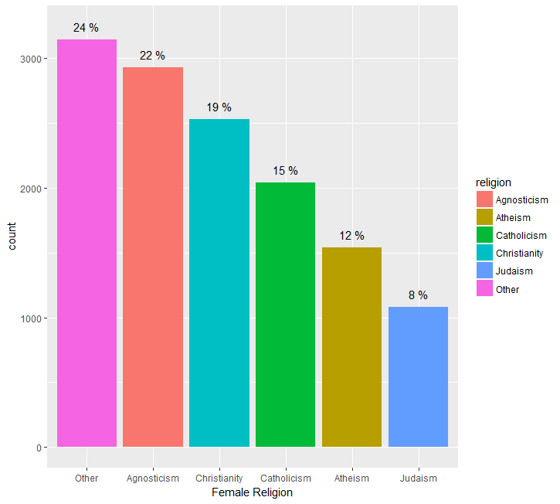
What kinds of people populate the San Francisco dating scene?
-Religion by Sex = Female
Religion and Sex selected.
Data sorted by religion count, top 20 religions looked at and grouped.
Top 2 religions very close
Fairly consistent and gentle slope

Slide 13
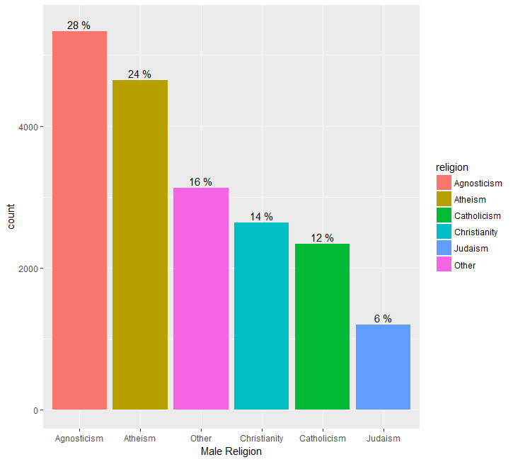
What kinds of people populate the San Francisco dating scene?
-Religion by Sex = Male
Religion and Sex selected.
Data sorted by religion count, top 20 religions looked at and grouped.
X axis shows religion.
Y axis shows frequency.
Noticeable drops after top 2 and middle 3 religions.

Slide 14
What kinds of people populate the San Francisco dating scene?
-Religion by Both Sexes

Slide 15
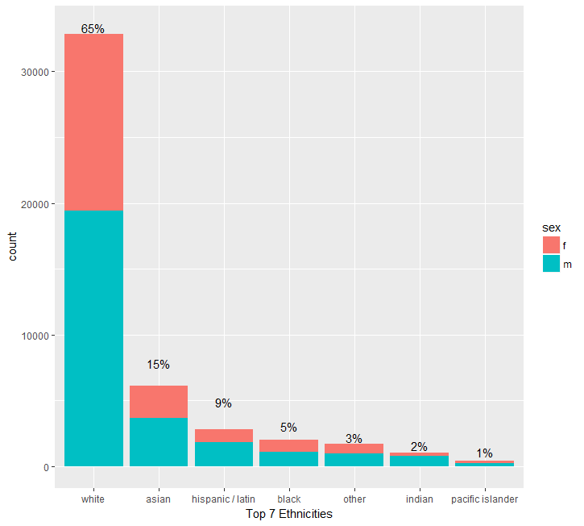
What kinds of people populate the San Francisco dating scene?
-Ethnicity and Sex
Ethnicity and Sex selected.
Top 20 ethnicities looked at and grouped into top 5 ethnicities + other. Count for each ethnicity graphed while using sex as fill.
X axis shows top 6 ethnicities.
Y axis shows frequency for each ethnicity.
White much more prevalent than other ethnicities.

Slide 16
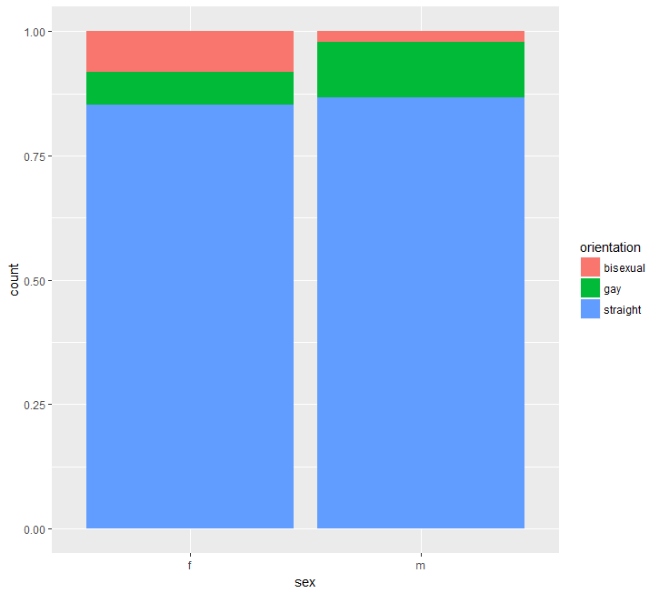
What kinds of people populate the San Francisco dating scene?
-Orientation by Sex
Orientation and Sex selected.
Orientation chosen as fill for Sex as x axis. Proportion instead of count shown.
X axis shows the two sexes.
Y axis shows proportion of orientation.
Men more likely to be gay than women
Women more likely to be bisexual than men

Slide 17
What kind of habits should we expect to find amongst SF OKCupid users?
For each gender, what habits can we expect to find for…
Drug use?
Drinking?
Diets?
Figuring out the most common habits for such categories will shed some light into San Francisco culture and give us an idea of what each sex is up to.

Slide 18
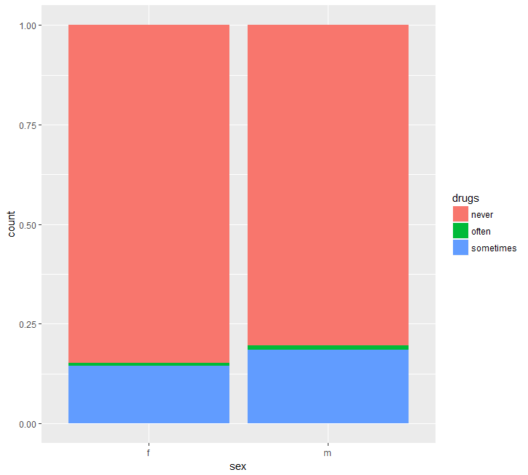
What kind of habits should we expect to find amongst SF OKCupid users?
-Drugs by Sex
Drugs and Sex selected.
Drugs chosen as fill for Sex as x axis. Proportion instead of count shown.
X axis shows the two sexes.
Y axis shows proportion of drug habits.
Men are very slightly more likely to use drugs “often”
Men are more likely to use drugs “sometimes”

Slide 19
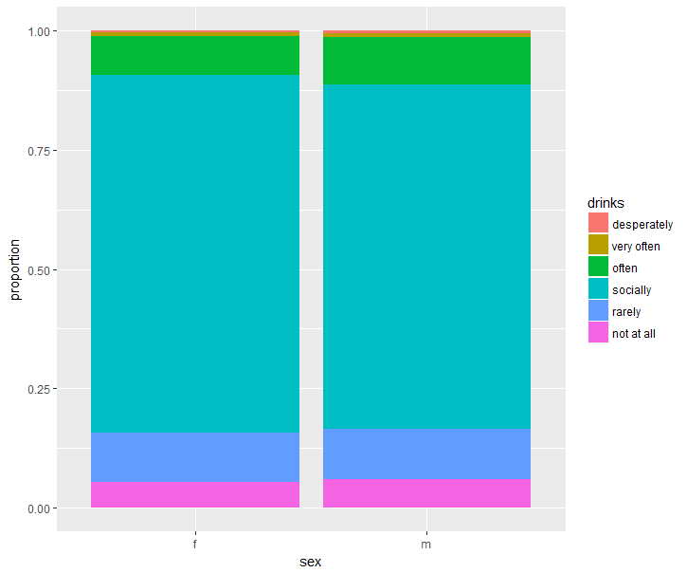
What kind of habits should we expect to find amongst SF OKCupid users?
-Drinking by Sex
Drinks and Sex selected.
Drinks chosen as fill for Sex as x axis. Proportion instead of count shown.
X axis shows the two sexes.
Y axis shows proportion of each drinking habit.
Women are slightly more likely to drink “socially” than men
Men slightly more likely to drink “not at all” or “often” than women
Proportions relatively consistent otherwise

Slide 20
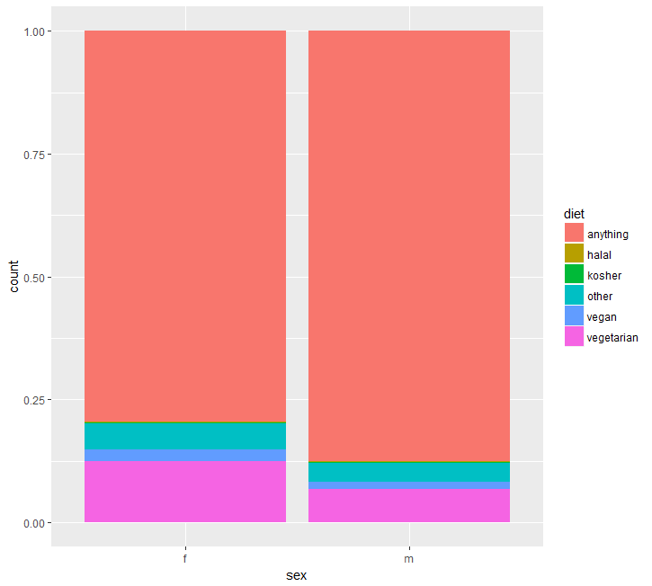
What kind of habits should we expect to find amongst SF OKCupid users?
-Diet by Sex
Diet and Sex selected.
Diet chosen as fill for Sex as x axis. Proportion instead of count shown.
X axis shows the two sexes.
Y axis shows the proportion of each diet habit.
Men are significantly more likely of eating “anything”
Women are significantly more likely to be “vegetarian”
Women are more likely to follow “other” diets or be “vegan”

Slide 21
How do OKCupid users compare to the average American/San Francisco resident?
How does the average American/San Francisco resident compare to OKCupid users when it comes to…
Sex?
Height?
Income?
Ethnicity?
Answering these questions will allow us to discern whether SF OKCupid users tend to be above or below average when it comes to certain characteristics. Perhaps the virtual dating landscape doesn’t reflect San Francisco very well.

Slide 22
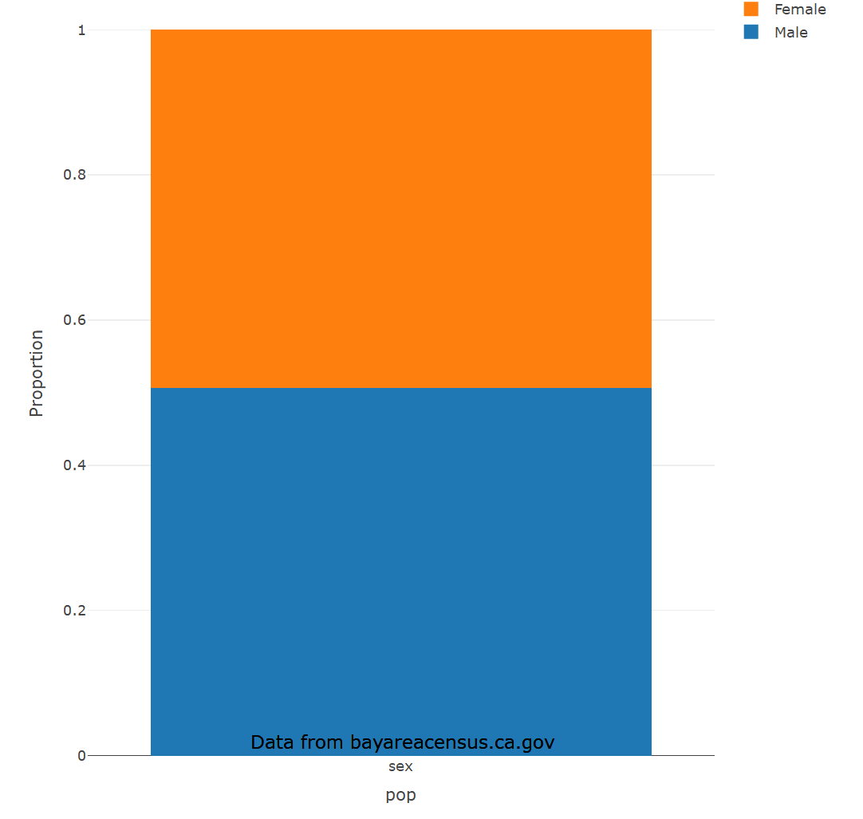
How do OKCupid users compare to the average American/San Francisco resident?
-Sex

Slide 23
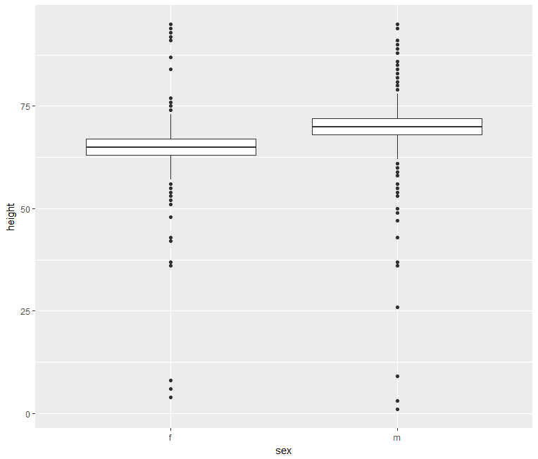
How do OKCupid users compare to the average American/San Francisco resident?
-Height by Sex
Height and Sex selected.
Height filtered to only include data > 0. Data summarized showing median height for each sex.
X axis shows the two sexes.
Y axis shows height in inches.
70.44 in
65.10 in
Male median is 70 in. (5’10)
Mean is 70.44 in. (5’10.4)
Female median is 65 in. (5’5)
Mean is 65.10 in. (5’5)

Slide 24
How do OKCupid users compare to the average American/San Francisco resident?
-Height by Sex
70.44 in
65.10 in
U.S.A. Average Height (in.)
Men | Women
69.5 (5’9.5) | 63.8 (5’4)
Source: livestrong.com

Slide 25
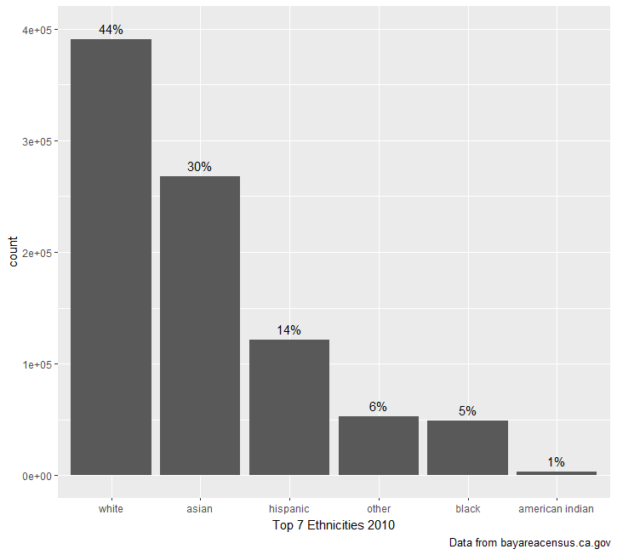
How do OKCupid users compare to the average American/San Francisco resident?
-Ethnicity

Slide 26
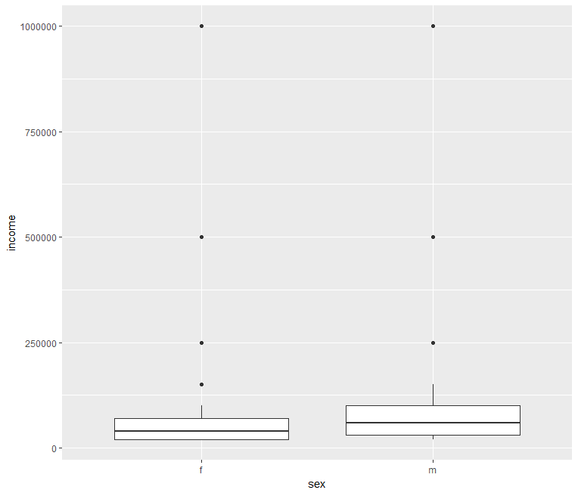
How do OKCupid users compare to the average American/San Francisco resident?
-Income by Sex
Income and Sex selected.
Income filtered to only include data > 0. Data summarized showing median income for each sex.
X axis shows sex the two sexes.
Y axis shows income (in $).
Male median is $60,000
Mean is $110,984.4
Female median is $50,000
Mean is $104,395

Slide 27
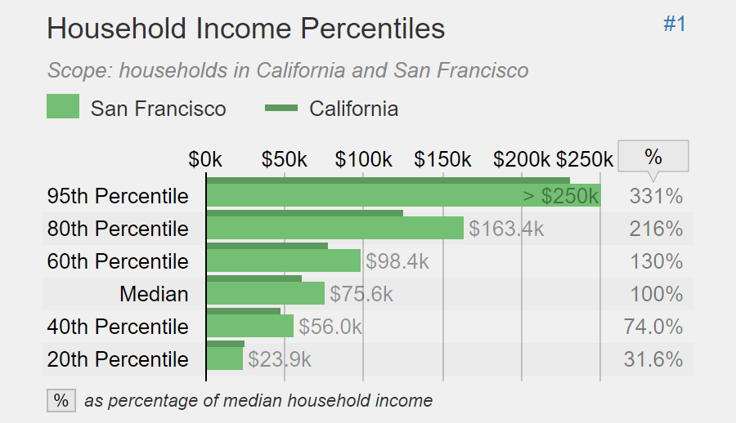
How do OKCupid users compare to the average American/San Francisco resident?
-Income
$50,000
$60,000
Source: statisticalatlas.com
OKCupid Individual Income
San Francisco Household Income

Slide 28
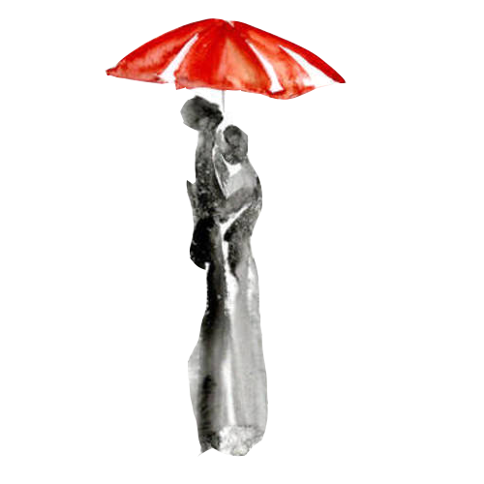
Conclusions
Sex
6:4 Male-Female split
Women have a much easier time finding men
Age
Most users in the 22-35 age range
Body Type
Men tend to be Athletic, Average, Fit, and not much else
Suspicious
Women tend to be Average, Fit, and Curvy
Ethnicity
Whites strongly overrepresented
Orientation
Men likelier to be gay than women
Women likelier to be bisexual than men

Slide 29

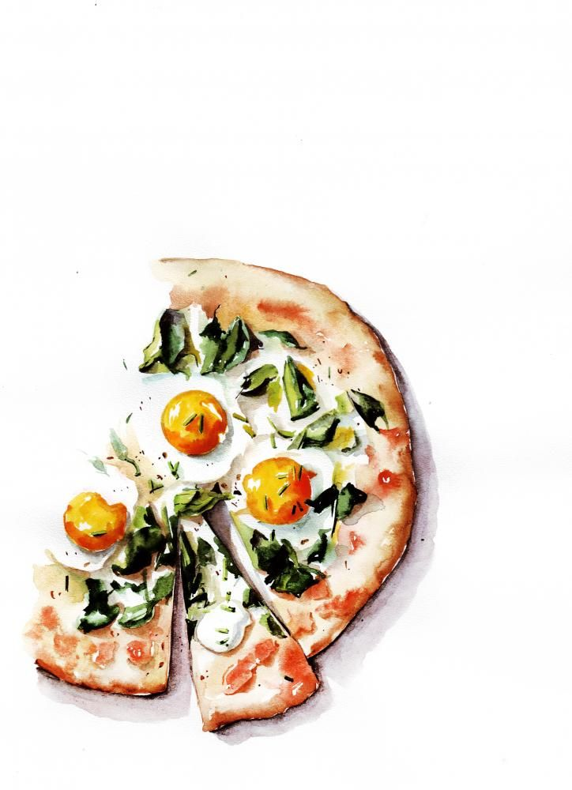
Conclusions
Drugs
Men more likely to use drugs sometimes and often
Drinking
Women more likely to drink socially than men
Men more likely to not drink or to drink often
A gender of extremes
Diet
Men more likely to not have a strict diet
Women more likely to be vegan or vegetarian

Slide 30
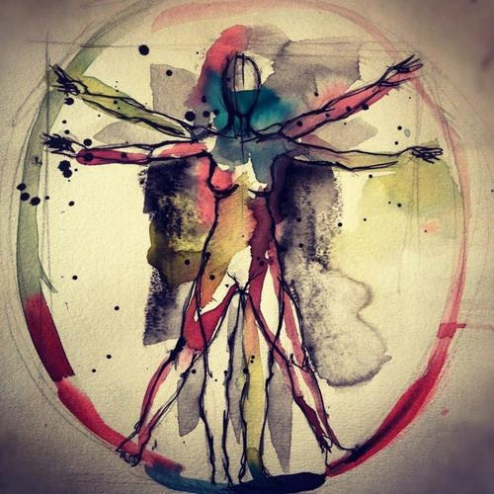
Conclusions
Sex - OKCupid vs SF
OKC 6:4 Male-Female split vs SF 5:5 Male-Female Split
Males overrepresented
Men might be more likely to look for dates in general
Men might be more likely to use online dating
Height - OKCupid vs America
Men and women are around an inch taller than the average American
San Francisco residents might receive better exercise and nutrition than the average American
Online daters might be boosting their height slightly to look more appealing

Slide 31
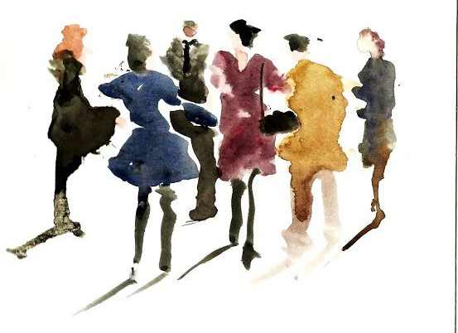

Conclusions
Ethnicity - OKCupid vs SF
Whites overrepresented in both populations but significantly more so in OKCupid
White people might be more likely to search for dates online
OKCupid might appeal to white people more
Perhaps East meets East and such draw certain ethnicities away from OKCupid
Income - OKCupid vs SF
Median income for men is 20% more than women
Men might be more likely to disclose income
Mean income for men and women is nearly double the median
Men and women with high incomes are more likely to disclose it
Median income for men and women is below San Francisco median household income
Not a completely fair metric, but relative closeness makes OKCupid seem truthful

Slide 32
Conclusions
People sometimes fear that online daters aren’t very truthful in their profiles, but OKCupid users in San Francisco don’t seem to be lying about their attributes.
If you plan on using OKCupid in San Francisco, you’re likely to be pleasantly surprised by the physical characteristics of the people you meet.
However, if you’re looking for more variety in when it comes to ethnicities or orientation, then OKCupid might not be the app for you.

Slide 33

Conclusions
If you’re looking for an athletic, white, agnostic, straight man or an average, white, agnostic, straight woman, then you just might be in luck.
Turns out finding people online isn’t that different from finding people offline.

Slide 34
A Long Look at Love
(San Francisco Edition)
Rodrigo Arguello

